Slide 1




Towards Cost-Effective Low-Delay Cloud-Assisted Video Conferencing
May 2014
Mohammad H. Hajiesmaili,
Minghua Chen, Lok To Mak
Zhi Wang
Chaun Wu
Ahmad Khonsari
Notes:
(1 min) Thank you … for introducing me, and welcome everybody. First, I would like to thank INC for supporting me during the past 6 months. Also thanks for Prof. Minghua for his great support during this period.
This work is done during past 6 months when I was here as a RA. Today, I am going to talk about the project. This is a joint work with

Slide 2
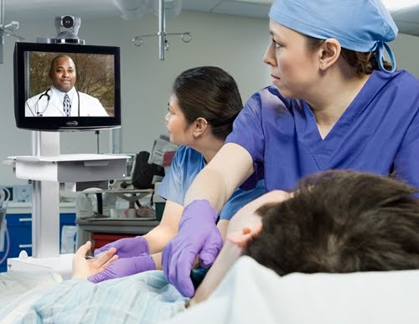

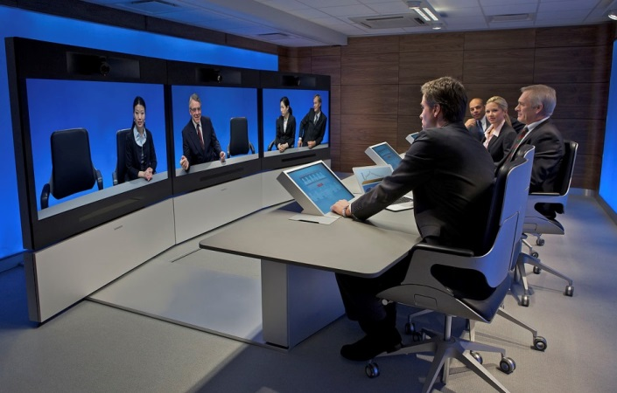
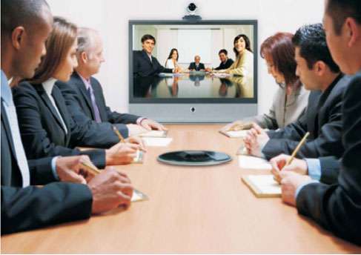
Video conferencing applications
Tele-health-care
Online education
Press Agency
International Business
With 51.7% annual user growth^{[1]}: video conferencing is the fastest-growing multimedia service
Video conferencing users will surpass audio conferencing users by 2015
Notes:
(1:30 min) Before moving to the main problem, let me start with a brief introduction of diverse applications of video conferencing. By the recent advances in high capacity networks, multimedia systems, and mobile computing, there has been a rapid growth in the applications of VC in different areas such as tele-medicine, online-education, media, and business. In this way, video conferencing could be considered as a virtual face-to-face communication among separate parties, as a green alternative to reduce the need to travel long distances.
No so surprisingly, VC is the fastest-growing multimedia networking service with about 52% growth in users per year, and VC users will surpass audio conferencing users by the end of 2015.

Slide 3
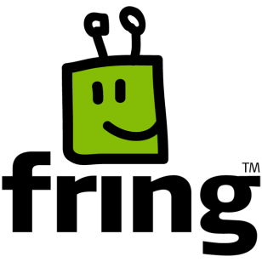





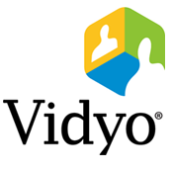
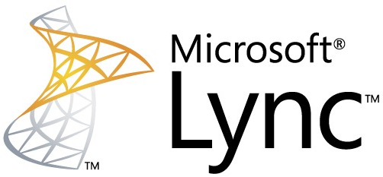

Multi-party video conferencing
10
3
4
10
12
2
4
2
15
The maximum no. of parties in a session
Notes:
(1 min) You can see here in this slide just a subset of several popular video conferencing solutions. If you think back to a couple of years ago, most of these applications just support 2-party video conferencing, which means there are just two people in a conferencing session. But, the recent demands along with the advances in technology motivates to offer multi-party video conferencing solutions, which means it is possible to start a conferencing session with 3, 4, or more number of parties.
As an example you can here that most of these applications currently support multi-party video conferencing.

Slide 4
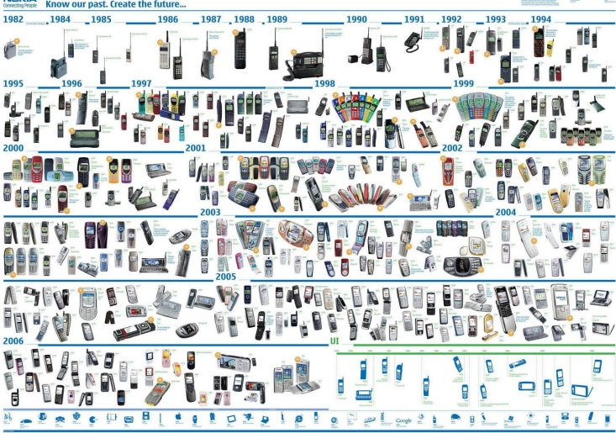
Key Challenges in Video Conferencing
1. High bandwidth and processing demand by heterogeneous users
High processing demand
  Transcoding is required
    Resolution (~ 100)^{[1]}
    Hardware (~ 2800)
    Mobile OS (~ 14)
    Request for more than 40 different representations
  High bandwidth demand
  HD support
2. Stringent end-to-end delay constraints
ITU-T Recommendation G.114
Delay <=150 is good, the same as PSTN
Delay >400, unacceptable
Notes:
(3:30 min) Despite the popularity, VC is a challenging system.
Actually, there are two main challenges that should be addressed in a proper design.
The first one is high bandwidth and processing demand by heterogeneous users.
Almost all VC solutions support mobile devices, so the users in video conferencing are mainly users with different mobile devices.
But, mobile devices are highly diverse in terms of screen resolution in which currently there are about 100 different resolutions in mobile devices, in hardware spec, about 2800 different specs., and also in mobile operating systems, about 14.
So, this heterogeneity means that each mobile device just can support a subset of different versions or representations of all possible versions in terms of encoding, resolution, and bitrate. According to this measurement, at least there are 40 different versions for video recorded by mobile devices that many of them are not supported in some other devices.
So, for a good conferencing experience, a proper design should support the inter-operability of different video representations. This is done by performing “on-the-fly” conversion procedures, like transcoding, which mean converting a version of video to another version. For example converting the resolution of the video file.
But, transcoding is a high demand task and actually resource-poor mobile devices are not good candidates for doing such tasks. So, this challenge should be addressed in another way. On the other hand, almost all VC solutions and mobile devices support high quality video conferencing, so not only video conferencing is a high demand task due to the transcoding, but also it is a high bandwidth service due to the HD support.
The second challenge is the stringent end-to-end delay requirements of users.
According to ITU-T recommendation G.114, the maximum tolerable delay for real-time video application is less than 400 milliseconds. It also says that the delay around 150 milliseconds is acceptable and the experience is the same as PSTN. Thus a proper VC design should addressed these two challenges.

Slide 5
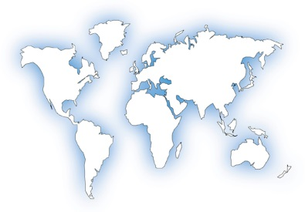










Client-Server Architecture
Peer-to-Peer Architecture
Servers help in resource-intensive tasks
Fail to resolve high demand challenge
Delay can be considerable
Low delay conferencing
Notes:
(4 min) Here, in this slide, I am going to compare the alternative architectures of VC in handling the previous two challenges.
So, the architectures are the traditional client-server architecture, the peer-to-peer architecture.
So, lets focus first on CS architecture. In this model, a central server as a single node maintains the whole session. For example, in this Fig. you see a 4-party conferencing session, within different parties with heterogeneous devices. So, here participants communicate each other through the central node here. This architecture suffers from long conferencing delay due to considerable distance from the servers. But, servers can help in resource-intensive tasks, and in this way, we address the problem of high processing demand. So, CS architecture fails to handle the delay requirement but it can address the high demand challenge.
In the second architecture, the participants directly talk to each other in peer-to-peer fashion. So, in this way, direct connections between users in full-mesh P2P results a low delay experience. But, in this model, there is not any central powerful node to accomplish the resource-intensive tasks, and clearly the resource-poor mobile device are not good candidates to do these tasks. So, the same as the previous architecture P2P can address just one of two key challenges of VC.

Slide 6





State-of-the-Art Cloud Architecture for Video Conferencing
Users only care about sending/receiving video streams to/from the agents
Cloud agents accomplish all resource-intensive tasks.
Cloud-assisted solution CAN address the two key challenges
But it brings out new design challenges
High demand: by moving the tasks into the agents
Delay requirement: by reliable and dedicated backbone
Notes:
(2:30 min) Let me talk about the state-of-the-art cloud architecture. So, in this architecture the cloud provider leases several agents in different geographical locations. For example, here there are four agents, in NA, EU, SA, and Asia. So, these agents are connected together using the dedicated cloud backbone. And by starting a conferencing session users subscribe to a cloud agent. This a sample subscription here, that users just subscribe to the nearest agent in cloud.
In this way, users only care about sending/receiving video streams to/from the agents. On the other hand, cloud agent can accomplish all resource-intensive tasks. Thus, lightweight operations at clients reserve the battery of users devices. And performing high demand tasks in resource-rich cloud infrastructure result a high quality conferencing.
So, this architecture can address the two challenges properly. The high demand challenge is addressed by moving the tasks into the agents and delay requirements is done by subscribing to a proper agent and by the dedicated cloud backbone.
But, this architecture brings out some new design challenges that we are going to talk about in the next slide.

Slide 7

Operational costs of the service provider
Cost of using the cloud can be high (processing and data transfer)
  According to our estimate, if Skype moves to cloud and just 20% of its traffic requires data transfer between agents, then the monthly bill will be about 2 million USD.
Notes:
(3 min) Despite the benefits provided by the cloud architecture, it is an expensive architecture. Actually the cost of cloud for the service provider of video conferencing application is the cost of hiring virtual machines, which is the processing cost. Another is the data transfer cost. In charging model of commercial cloud provider the data transfer between different regions, or agents in our case is not free.
According to our estimate if Skype moves to cloud and just 20% of its traffic requires data transfer between agents, then the monthly bill will be about 2 million USD.

Slide 8
Subscription policy is the key mechanism that can make a big difference in delay and cost
JP
SFU
OR
67
TO
117
27
CUHK
81
45
150
20
SP
SG
181
BR
Notes:
(4:30 min) So in this slide we are going to explain that the subscription policy, which means the decision on which agent should host the user, is the mechanism that can make a big difference in both delay and cost.
Let me explain the importance by an example. So, consider these 4 cloud agents. This agents are located in OR, SP, TO, and SG which are the locations the data centers of the world premiere cloud provider, Amazon. and these values are the measured latencies. Consider two colleagues in Singapore start a conferencing session. One in NUS, another one in NTU. So, nearest policy says the subscription of both the users to the agent located in Singapore. After a little while, another colleague in TW joins them in the conferencing session. So, the service provider should find a proper agent for TW user. Nearest subscription suggests Tokyo agent, since the latency is only 40 milliseconds which is the minimum latency. So, in this way, the delay of flow of TW to NUS user is at least 40+45+ this delay, without considering transcoding latency. In this subscription, also, the inter-agent traffic between the Tokyo and Singapore is required.
But, lets take a look at another subscription. The delay between TW user and Singapore is 50 milliseconds, which is just 10 milliseconds higher than the nearest one. But, by subscribing the user to Singapore agent the delay is just 50 + this delay which is significantly lower than the previous plan. In addition, in this subscription, there is no need to data transfer between the agents.
This simple toy example clearly demonstrate that the nearest policy is not the optimal subscription policy.
But, by this simple example, one may argue to subscribe all users into a single agent and the subscription is so trivial. By the next example we demonstrate that when the number of parties in a session grows, the subscription is so challenging.
So, lets consider another session. The blue ones with three users, the first one in Brazil, the second one in Canada, and the third one in Japan. So, these users are in different continents. And clearly it is not possible to subscribe them into the agents in another continent. So, in this way we subscribe Brazil user into SP agent. SFU user into Oregon agent, and Japan user into Tokyo agent. OK.
There is another user in this session which is here, for example in CUHK. So, nearest policy selects Singapore agent for this user since the delay is just 20 milliseconds. But, considering inter-agent values, we see that Tokyo agent is nearer to the other agents in SP and OR. For example 67 vs. 117. So, although the delay of CUHK user to Tokyo is a little bit higher than the delay to SG, subscribing CUHK user into Tokyo agent reduces the end-to-end delay significantly.

Slide 9



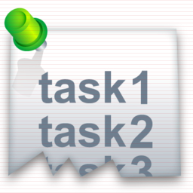
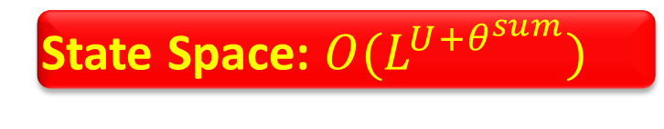
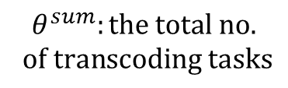
Key question
What is the optimal user-transcoding subscription that minimizes the delay and the costs?
U: the total no. of users
User/Transcoding Subscription (UTS)
L: the total no. of cloud agents
State Space: $O(L^{U+θ^{sum}})$
Delay Constraint
Capacity Constraint
$$θ^{sum}:the total no.$$
$$of transcoding tasks$$
Notes:
(1:30 min) By the previous example we show the importance of subscription policy in both conferencing delay and traffic cost of the service provider.
So, our main question is here, What is the optimal user and transcoding subscription that simultaneously minimizes the delay and the costs?
So, put in another way, we are given the set of users in multiple sessions, the set of transcoding operations, and the set of pre-instantiated cloud agents. The problem is to find the optimal subscription. But, the state space of the problem is the number of agent to the power of the aggregation of the number of users and the number of transcoding tasks.
On the other hand, there are two sets of constraints in the problem, which makes the problem more difficult.
The first one is the delay constraint, which says that the delay of each flow should be less than a particular values, 400 milliseconds, say.
The second one is the capacity constraint of the agent, which is divided to bandwidth and processing capacity constraints.

Slide 10

Contribution
We provide the first possible answer to the important question
  We devised a parallel and adaptive algorithm based on Markov Approximation framework with sound performance guarantee.
  We carried out Internet-scale experiments and our solution outperforms alternative solution by 77% cost reduction with better conferencing delay.
Our solution can save up to 1.54 million USD per month for Skype (assuming it moves to cloud)!
Notes:
(1:30 min) In this slide you see the main contributions.
Towards solving the user/transcoding subscription problem and after formulating the problem, we will propose an approximate algorithm, the algorithm runs in parallel in sessions and can handle dynamics in system model. Moreover, the performance of the solution is guaranteed by the optimality gap.
In addition, we propose a session bootstrapping algorithm that could be considered as a good initial point of the first algorithm to reduce the convergence. Also, it provider higher success rate of subscription given limited capacity of agents.
By experiments we have implemented a prototype of actual cloud-assisted conferencing system. Since the actual system is an small system we also run some internet-scale trace-driven experiments to evaluate the performance of our design.

Slide 11






Problem formulation: User/Transcoding Subscription (UTS)
Delay
Traffic
Processing
Delay/cost objective function
subject to:
Bandwidth capacity constraints
Transcoding capacity constraint
delay constraint
Integer variables
Notes:
(1:30 min) Here , I wanna explain the problem formulation.
The objective is a hybrid objective of three parts, the first part is delay, in the perspective of the users, the second one is traffic cost, and processing cost. These coefficients are design parameters and could be set by the service provider.
The first set of constraints are bandwidth capacity constraints, which is divided into two download and upload capacity constraints.
The second is the transcoding capacity constraint. Here, t_l is the transcoding capacity of agent l.
And the last one is the delay constraints, that says that the end-to-end delay of flow user u to user v for all flows should be less than or equal to a particular value dmax, 400 milliseconds, say.
The optimization variables are also this one, the user subscription variable and the transcoding subscription variable. The optimization variables are integer in our problem. So the problem is a combinatorial optimization problem.

Slide 12
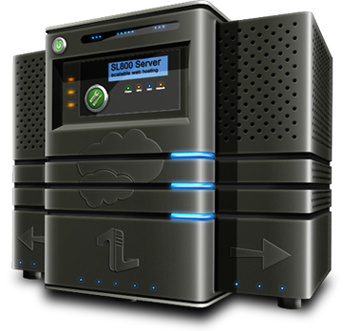

Solution approach
A Naïve approach is not applicable
  Use abundant cloud resources to solve the problem
    High computational complexity
    Can not handle dynamics in sessions and agents
Parallel and adaptive solution is preferred
  By Parallel solution, each session can solve its subscription problem locally
    Scales with the problem size
  Adaptive solution tackles the dynamics
The solution can be an approximate solution
Notes:
(1 min) So, the problem is a non-linear combinatorial problem, which is generally difficult to solve. In addition, in this scenario, the parallel and adaptive solutions are interested.
By parallel we mean to solve the problem locally in each session using just local information so as to obtain a global optimal solution. In this way, the solution can scale with the problem size.
By adaptive solutions, we can tackle the dynamics in system model, for example we can handle session arrival/departure.
But, the solution could be approximate solution. But, in this way, we should evaluate the performance of the approximation by characterizing the optimality gap.
Every moment we can collect all the information for solving the problem, then solve the problem centrally in a central node in cloud, and then send back to solution to the sessions to subscribe according to the new solution.
But in this approach there are two problem 1. computational complexity is high and it could takes a lot time. 2. Whenever there is dynamics in system, for example session arrival departure and changes in capacity of agents we need to collect the information again and solve the problem again, so this is not ideal. So, ideally a solution should be adaptive and hopefully could be implemented in parallel manner. You can tackle the complexity by leveraging a lot of agents in the cloud.

Slide 13
Markov approximation framework
Combinatorial network problems
Formulation
Log-sum-exp approximation
Parallel Markov Chain Design
Notes:
(3 min ) As a solution approach we leverage the recently-proposed Markov approximation framework to solve our problem.
Let me briefly talk about the idea behind the Markov approximation framework.
Actually, this is a general framework to solve combinatorial network problems.
To solve the problems in this framework, the first step is to formulate the problem in standard form of this framework.
The next step is to approximate the standard problem using log-sum-exp approximation. We can derive a closed-form solution for this problem. The main idea is here, where in the basic version it is shown that for any solution of this approximate problem, there exists at least one continuous time time-reversible Markov chain whose stationary distribution is the solution of this problem.
So the key is here, if we can implement the Markov chain in a distributed manner, then as the Markov chain converges, the configuration will be time-shared according to the optimal stationary distribution and the system will stay in the best configuration most of the time.
To imagine the intuition behind the framework, let me explain the main idea in another way. So, consider we are going to solve the problem by exhaustive search. So there are multiple feasible configuration set, which is usually exponentially large, and then for each configuration there is some performance. In exhaustive search we visit every configuration, we compare its performance with the previous ones, keep the track of the best one and after you visit all the configurations we will find the best. Here, in this framework we are still doing a search in feasible configurations. But, the search in this framework is intelligent which is guided by an underlying Markov chain. So, the objective is to design a Markov in a way so that you towards to a good configurations and stay there for most of the time.
The next challenge is to design such a Markov chain in parallel manner, which are what we exactly want.

Slide 14
The intuition behind the framework
Naïve exhaustive search
Multiple feasible configurations, Performance in each configuration
Visit configurations and keep the track of the best configuration
After visit all the configurations we will find the best
Markov approximation framework
We are still doing a search in feasible configurations
The search is intelligent and is guided by an underlying Markov chain
The objective is to design the Markov in a way so that move towards a good configuration and stay there for most of the time
Notes:
(3 min ) As a solution approach we leverage the recently-proposed Markov approximation framework to solve our problem.
Let me briefly talk about the idea behind the Markov approximation framework.
Actually, this is a general framework to solve combinatorial network problems.
To solve the problems in this framework, the first step is to formulate the problem in standard form of this framework.
The next step is to approximate the standard problem using log-sum-exp approximation. We can derive a closed-form solution for this problem. The main idea is here, where in the basic version it is shown that for any solution of this approximate problem, there exists at least one continuous time time-reversible Markov chain whose stationary distribution is the solution of this problem.
So the key is here, if we can implement the Markov chain in a distributed manner, then as the Markov chain converges, the configuration will be time-shared according to the optimal stationary distribution and the system will stay in the best configuration most of the time.
To imagine the intuition behind the framework, let me explain the main idea in another way. So, consider we are going to solve the problem by exhaustive search. So there are multiple feasible configuration set, which is usually exponentially large, and then for each configuration there is some performance. In exhaustive search we visit every configuration, we compare its performance with the previous ones, keep the track of the best one and after you visit all the configurations we will find the best. Here, in this framework we are still doing a search in feasible configurations. But, the search in this framework is intelligent which is guided by an underlying Markov chain. So, the objective is to design a Markov in a way so that you towards to a good configurations and stay there for most of the time.
The next challenge is to design such a Markov chain in parallel manner, which are what we exactly want.

Slide 15
Markov chain design
The Markov chain design is application-specific
The state space is all feasible configurations
Design Space: Two degrees of freedom
    Add or remove transition edge pairs
    Designing transition rate
Parallel implementation by
  We allow only one change in each transition
    Just one session is subject to change
  The transition rate is proportional to the difference of local objective of the current and the target subscription.
Notes:
(3 min) So the objective is to design a Markov chain. But this design is application-specific and the goal is to design such a Markov chain so as to be realized in a distributed manner.
Clearly, the state space of the Markov chain is the set of all feasible configurations. But, by the following two degrees of freedom in designing Markov chain we can achieve a distributed solution.
The first one targets the connectivity structure of the Markov chain, and says that we are allowed to add or remove transition edges, given that the resulting Markov chain stays connected. The modified Markov chain is still TR and its stationary distribution is still the optimal solution of the approximate problem.
The second one targets the transition rates. for two states f and f’ that have direct transitions, there are many options in designing transition rate given that the detailed balance equation is satisfied.
By these two degrees of freedom and towards a distributed algorithm we just allow only one change in each transition. This means that we just allow two configurations with direct links when there is just one difference between their subscription.
In addition, we set the transition rate proportional to the difference of local objective of the current and the target subscription.
In this way, each session locally can implement the algorithm. Since in each transition just one subscription is subject to change and the rate of transition depends on the local objective of the session.
So, this design space enables us to construct a well-structured Markov chain that allows distributed implementation. The performance is guaranteed by the optimality gap, and could be map to a parallel and adaptive algorithm. Moreover, it can be shown that this algorithm design is robust to noisy measurement.

Slide 16
Session bootstrapping
The original Markov approach suffers from slow convergence.
When the agents‘ resources are limited
  Finding a feasible initial subscription is challenging
We are interested in a close-to-optimal initial point
  Faster convergence of Markov-based solution
  A resource-aware scheme to increase the success rate of subscription
Initialization by nearest policy
  Resource-oblivious
  Initial traffic cost is high
Notes:
(1:30 min) The Markov-based algorithm is an algorithm that runs in iterative manner and converges to a bounded neighborhood of the optimal point.
But, the original Markov chain approach suffers from slow convergence.
On the other hand, when the capacity of agents are limited, the capacity constraint is active and so finding a feasible initial subscription is challenging.
Putting together these considerations, in the next step we are interested to find a close-to-optimal initial point so as to
First provide a good initial conferencing experience, faster convergence of Markov-based solution, and finally a resource-aware scheme to increase the success rate of subscription given limited capacity of agents.

Slide 17



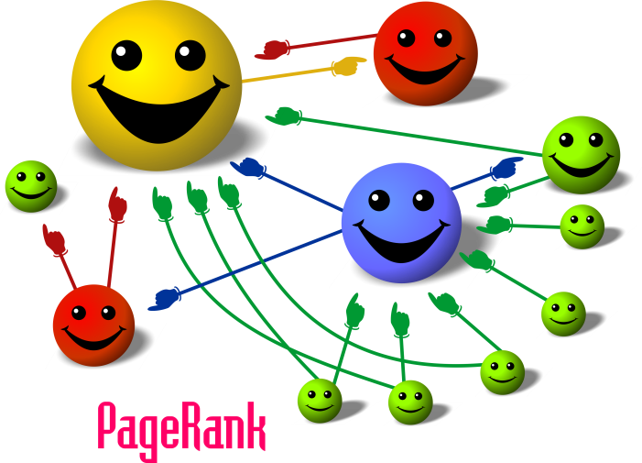
AgRank Algorithm
Constructs a set of potential agents:
Select top n^{ngbr} nearest agents
SFU
1
OR
67
TO
27
CUHK
Rank the agent based on:
Residual capacities
Inter-agent proximity
117
2
20
81
45
150
SP
SG
For each user select the top ranked agent in its vicinity
181
3
27+67=94 < 20+117=137
Inspired by Google PageRank
  To measure the popularity of web pages
We use the same theory
  To reflect both the residual capacities and inter-agent proximity in ranking
17
Notes:
(3 min) In the line of this goal, we proposed the second algorithm, called AgRank. The purpose here is just to find a proper initial subscription.
So the main idea is to rank the agents and then subscribe users according to this ranking.
Toward this, in the first step, we construct the set of potential agents of the session by selecting top n^ngbr nearest agent for each user. In this way, we consider the user-to-agent proximity as an important factor in our algorithm design.
The second step is to rank the selected agents. We rank the agents based on the residual-capacities, to attain a resource-aware solution, and also based on inter-agent proximity.
So, what is inter-agent proximity and why it is important in agent ranking?
In this example you can see the explanation. Just consider CUHK user. This user is close enough to both TO and SG agents. But, TO agent is more close to the other agents of the session in OR and SP. So, it is better to consider the proximity of agents together in agent ranking.
But, inter-agent proximity is a matrix-like property.
Here, we inspired by Google PageRank that is used by google search engine to rank the popularity of web pages, we used the same idea to reflect both the residual capacity and inter-agent proximity in agent ranking.
So, that’s it!, we just rank the agents and for each user select the top ranked agent in its vicinity.

Slide 18

Experiments
A prototype of real-world cloud-assisted video conferencing system
A set of internet-scale trace-driven experiments
6 Amazon EC2 instances
Oregon, Virginia, California, Tokyo, Singapore, Ireland
10 private PC nodes
5 nodes in North America, 4 nodes in Asia, 1 node in Europe
10 actual conferencing sessions
each with 3-5
participants
100 random runs
200/256 PlanetLab nodes
7 Amazon EC2 instances
~ 50 conferencing sessions
Tractable scenarios with actual data
Large-scale world-wide scenarios
Notes:
(2 min) Let me explain the experiments.
Our results are two-fold. The first one is a prototype of an actual cloud-assisted video conferencing system. This is done by a good work by Ben. In this system we used 6 amazon ec2 instances in 6 different locations. We have implemented a lightweight software to be installed in 10 private desktop computers in different universities. I should thank all of our friends that provide us remote access to computers. And finally we have lunched 10 actual conferencing sessions each with 3 to 5 participants. By this prototype system we evaluate the performance of our design is a tractable scenario but with actual data.
In the second set of experiments we have set up some internet-scale trace-driven users. In this experiments we have run 100 random scenarios. Each one with 200 users which are picked randomly among a set of 256 PlanetLab nodes. The agents are 7 Amazon EC2 instances. And so, in each random run we have 50 sessions or so.
This set of experiments are large-scale and show the effectiveness in large scale.

Slide 19
Simultaneous traffic and delay reduction on prototype system
Nearest policy as initialization
~75% inter-agent traffic reduction
~14% conferencing delay reduction
Notes:
(1 min)

Slide 20
Nearest policy as initialization
Notes:
(1 min)

Slide 21
Our solution can handle dynamics
6 sessions at initial time -> 4 more sessions arrive at t = 40 -> 3 sessions depart at t = 80
Notes:
(1 min)

Slide 22
Internet-scale Experiments
100 random runs each one with 200 PlanetLab nodes
77% traffic cost reduction
2% delay reduction
Notes:
(1 min)

Slide 23
Higher Success Rate of AgRank vs. Nearest
AgRank#3 initializes 100% of VC scenarios under average bandwidth capacity 750 Mbps, while resource-oblivious nearest policy can serve only 8% of scenarios.
Notes:
(1 min)

Slide 24

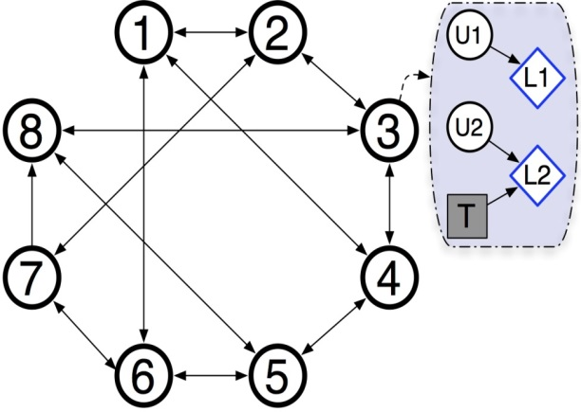




Conclusion
Cloud-assisted video conferencing
User/Transcoding Subscription
Markov approximation solution
User/Transcoding Subscription
subject to:
A significant cost and delay reduction in cloud-assisted video conferencing by an approximate solution.
  Parallel and adaptvie
  Close-to-optimal initialization
A win-win solution for both the users and the provider.
Notes:
(1 min) Ok, let me conclude the talk. In this project for the first time we consider the problem of cloud-assisted video conferencing from the perspective of the users and the provider. So, we formulate the problem and we solve the problem using a Markov-based parallel solution. In experiments we showed that there is a significant cost and delay reduction in our design. Also, the performance of our solution is guaranteed by an approximate solution. We also devise a close-to-optimal initialization.
In summary, we propose a win-win solution for both the users and the provider.

Slide 25
It is a beginning rather than an end
To improve the prototype system
  Implement the mobile version of the software
To improve the convergence of the algorithm
To consider the joint problem of optimal rate allocation and subscription
  Recent advances in delay-constrained networks
    Single unicast throughput with network coding
  Video conferencing
    Evinces delay-sensitivity
    But in multi-cast setting
Notes:
(1:30 min) Ok, let me mention some research directions in this project.
The first one is to improve the current version of the prototype system. A good direction is to implement the mobile version of the software.
Although we propose the session bootstrapping algorithm as a close-to-optimal point but, in our research team we are working to improve the convergence of the framework.
And finally, we are going to consider a joint problem of optimal rate allocation and subscription. Recently, another exciting work is done in our group in characterizing the capacity of single unicast networks in delay-constrained scenarios. Video conferencing is one application that evinces delay-sensitivity but in multi-cast scenario. We are looking forward to extend this fresh result in multicast scenario and apply them into our problem.

Slide 26
Thank you! mohammad@ie.cuhk.edu.hk
Notes:
So thank you very much for attending, any questions?

